Slide 1


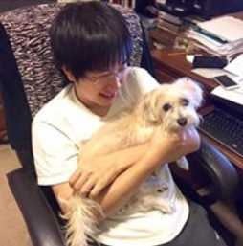



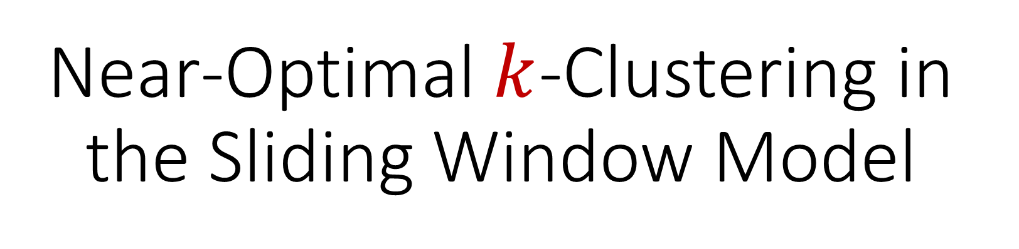
Near-Optimal $k$-Clustering in the Sliding Window Model
David P. Woodruff
Peilin Zhong
Samson Zhou

Slide 2
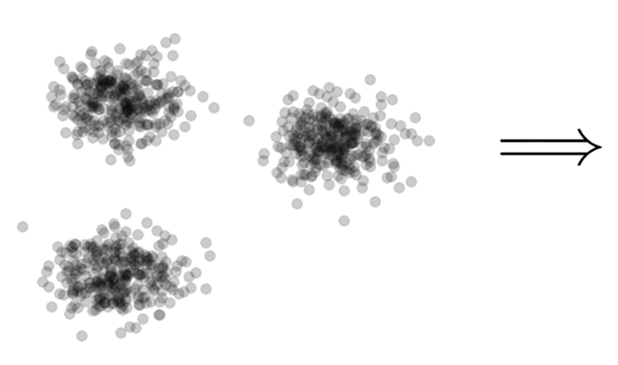

Clustering
Goal: Given input dataset $X$, partition $X$ so that “similar” points are in the same cluster and “different” points are in different clusters

Slide 3
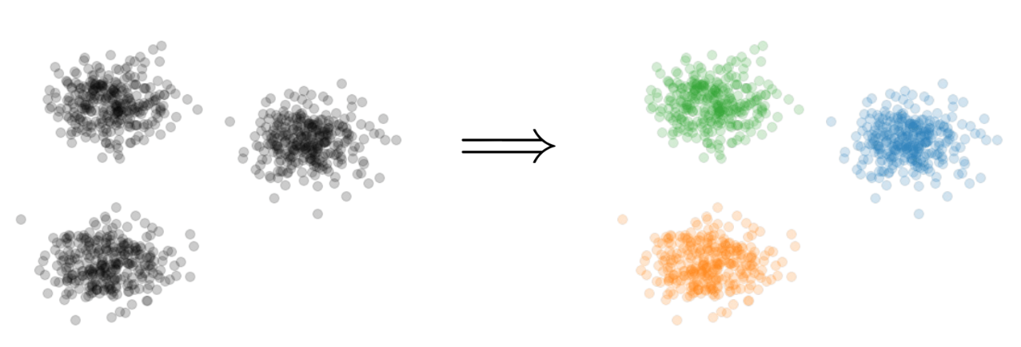
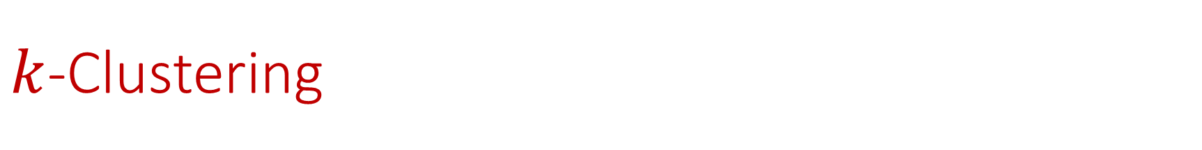

$k$-Clustering
Goal: Given input dataset $X$, partition $X$ so that “similar” points are in the same cluster and “different” points are in different clusters
There can be at most $k$ different clusters
$$k=3$$

Slide 4
$k$-Clustering
Question: How do we measure the “quality” of each clustering?
$$k=3$$

Slide 5
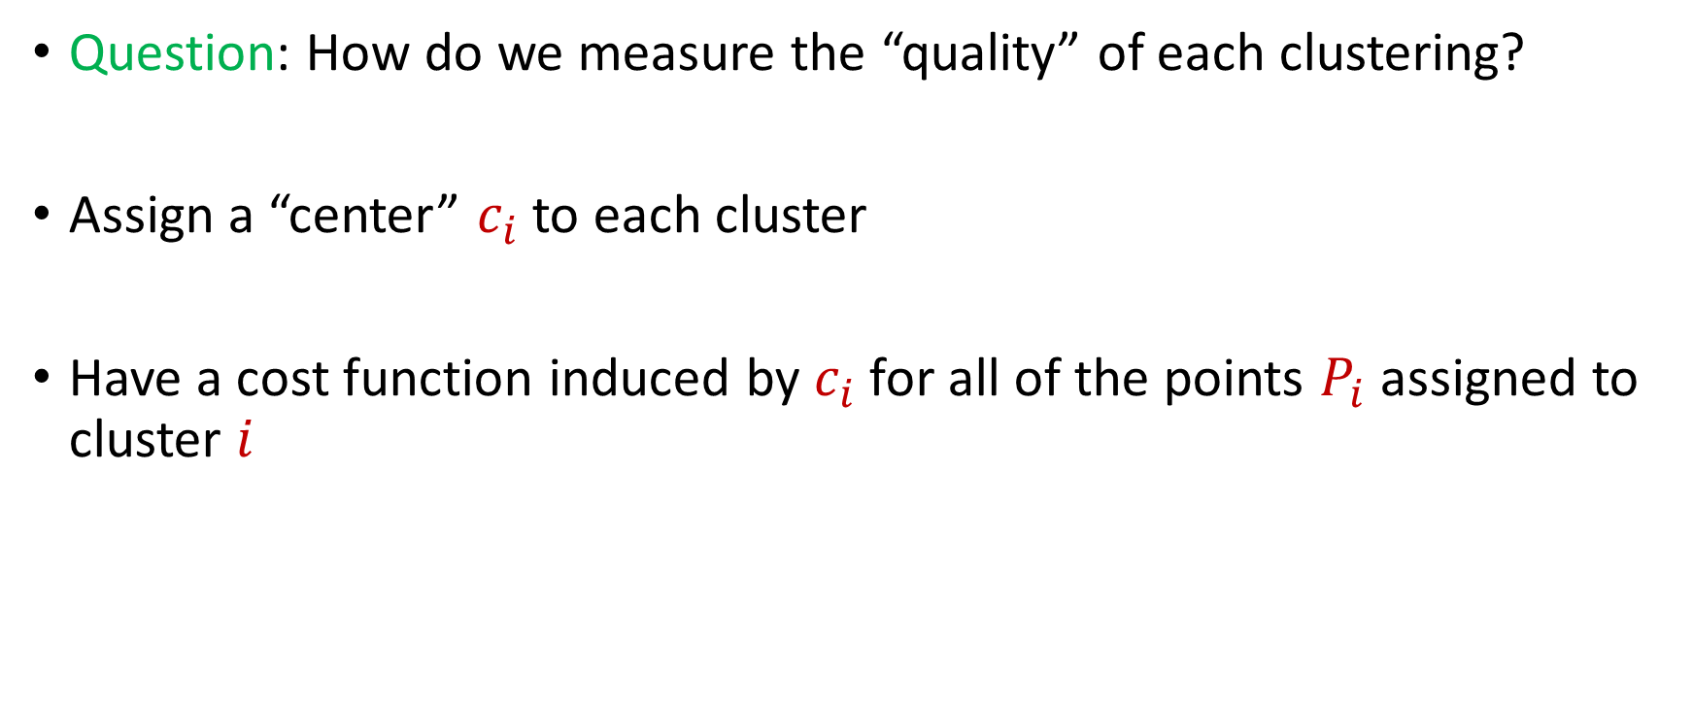
$k$-Clustering
Question: How do we measure the “quality” of each clustering?
Assign a “center” $c_{i}$ to each cluster
Have a cost function induced by $c_{i}$ for all of the points $P_{i}$ assigned to cluster $i$

Slide 6
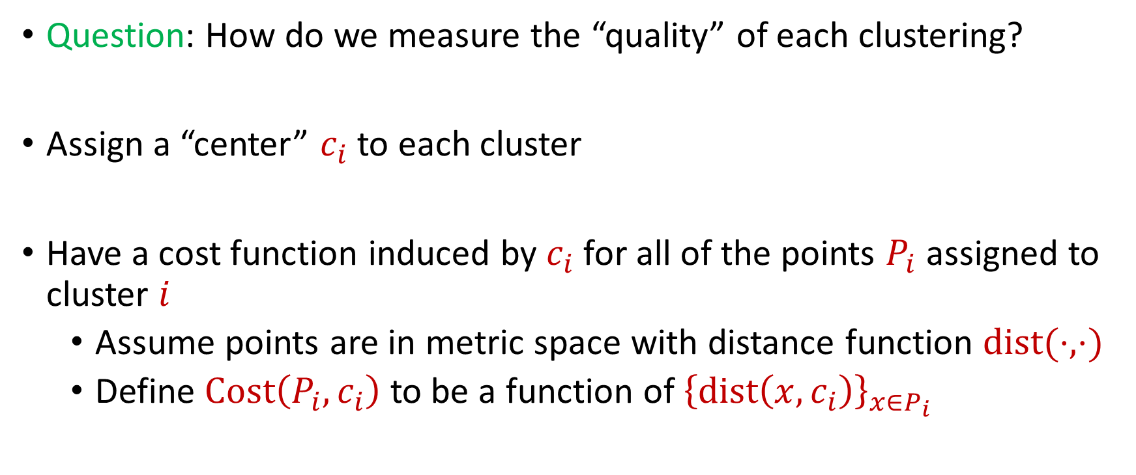
$k$-Clustering
Question: How do we measure the “quality” of each clustering?
Assign a “center” $c_{i}$ to each cluster
Have a cost function induced by $c_{i}$ for all of the points $P_{i}$ assigned to cluster $i$
Assume points are in metric space with distance function $dist(⋅,⋅)$
Define $Cost\left(P_{i},c_{i}\right)$ to be a function of ${\left\{dist\left(x,c_{i}\right)\right\}}_{x∈P_{i}}$

Slide 7
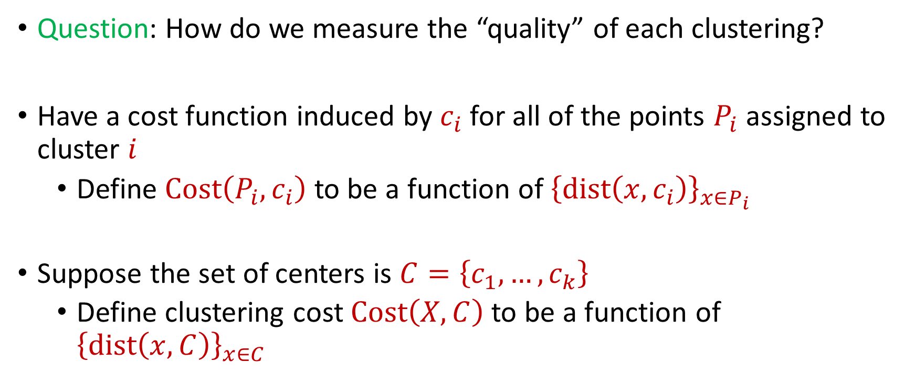
$k$-Clustering
Question: How do we measure the “quality” of each clustering?
Have a cost function induced by $c_{i}$ for all of the points $P_{i}$ assigned to cluster $i$
Define $Cost\left(P_{i},c_{i}\right)$ to be a function of ${\left\{dist\left(x,c_{i}\right)\right\}}_{x∈P_{i}}$
Suppose the set of centers is $C=\left\{c_{1},…, c_{k}\right\}$
Define clustering cost $Cost\left(X,C\right)$ to be a function of ${\left\{dist\left(x,C\right)\right\}}_{x∈C}$

Slide 8

$k$-Clustering
Define clustering cost $Cost\left(X,C\right)$ to be a function of ${\left\{dist\left(x,C\right)\right\}}_{x∈X}$

Slide 9
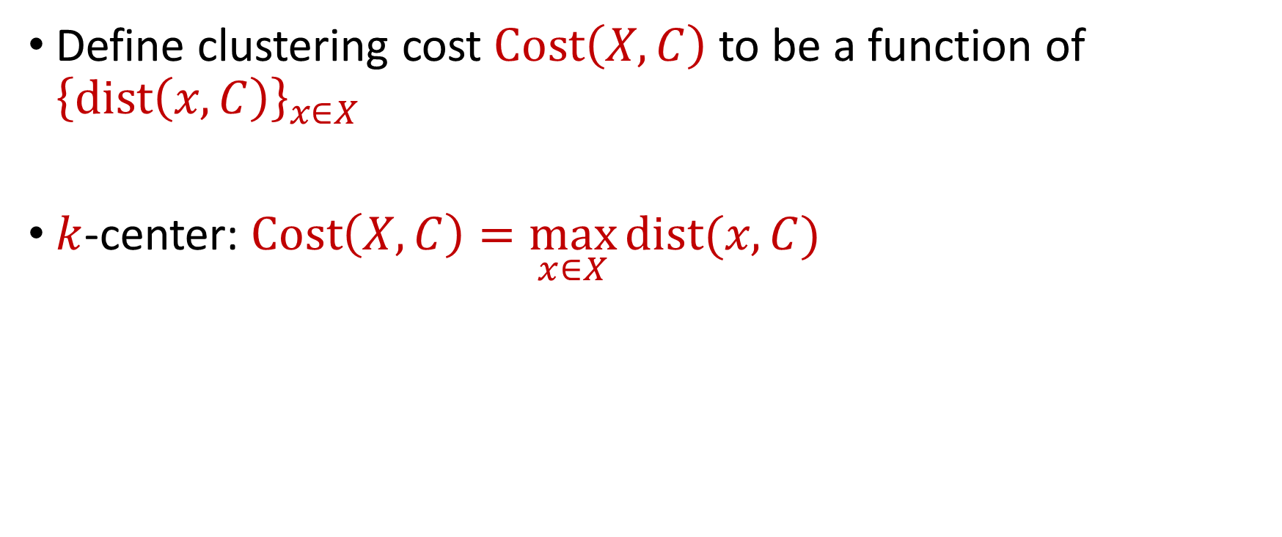
$k$-Clustering
Define clustering cost $Cost\left(X,C\right)$ to be a function of ${\left\{dist\left(x,C\right)\right\}}_{x∈X}$
$k$-center: $Cost\left(X,C\right)=\max_{x∈X}{dist(x,C)}$

Slide 10
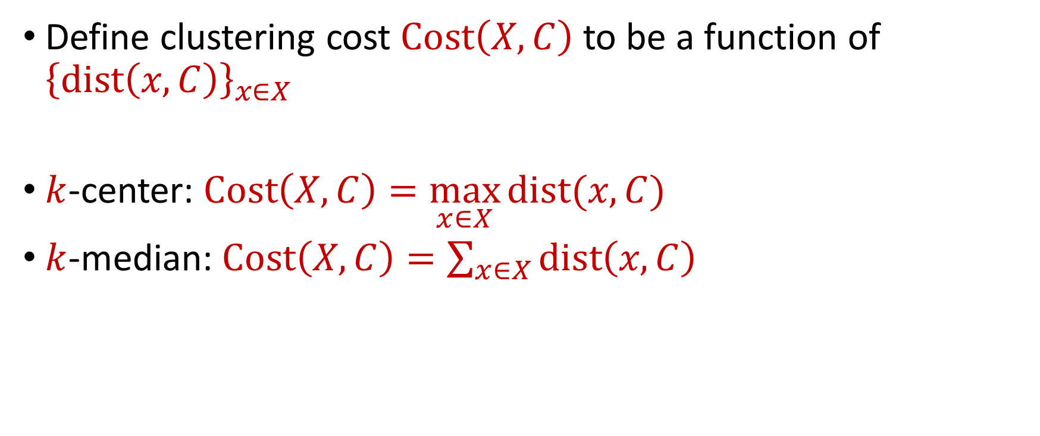
$k$-Clustering
Define clustering cost $Cost\left(X,C\right)$ to be a function of ${\left\{dist\left(x,C\right)\right\}}_{x∈X}$
$k$-center: $Cost\left(X,C\right)=\max_{x∈X}{dist(x,C)}$
$k$-median: $Cost\left(X,C\right)=\sum_{x∈X}{dist\left(x,C\right)}$

Slide 11

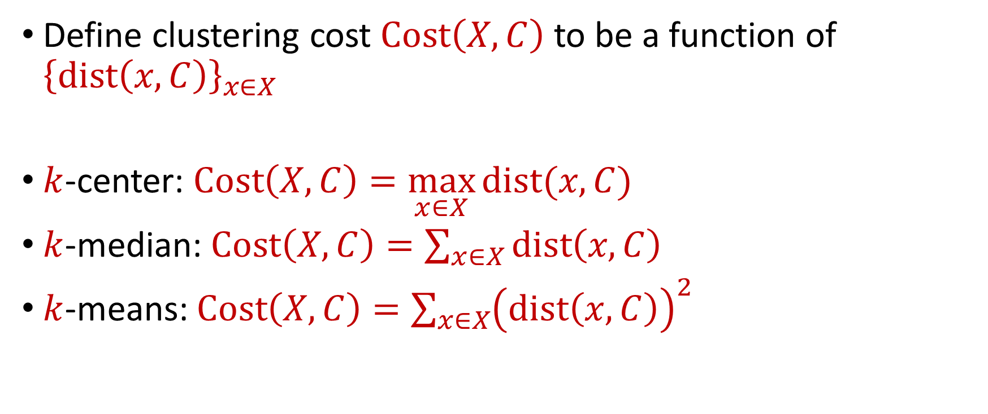






$k$-Clustering
Define clustering cost $Cost\left(X,C\right)$ to be a function of ${\left\{dist\left(x,C\right)\right\}}_{x∈X}$
$k$-center: $Cost\left(X,C\right)=\max_{x∈X}{dist(x,C)}$
$k$-median: $Cost\left(X,C\right)=\sum_{x∈X}{dist\left(x,C\right)}$
$k$-means: $Cost\left(X,C\right)=\sum_{x∈X}{{\left(dist\left(x,C\right)\right)}^{2}}$
$${\left(⋅\right)}^{2}$$
$${\left(⋅\right)}^{2}$$
$${\left(⋅\right)}^{2}$$
$${\left(⋅\right)}^{2}$$
$${\left(⋅\right)}^{2}$$
$${\left(⋅\right)}^{2}$$
$${\left(⋅\right)}^{2}$$

Slide 12

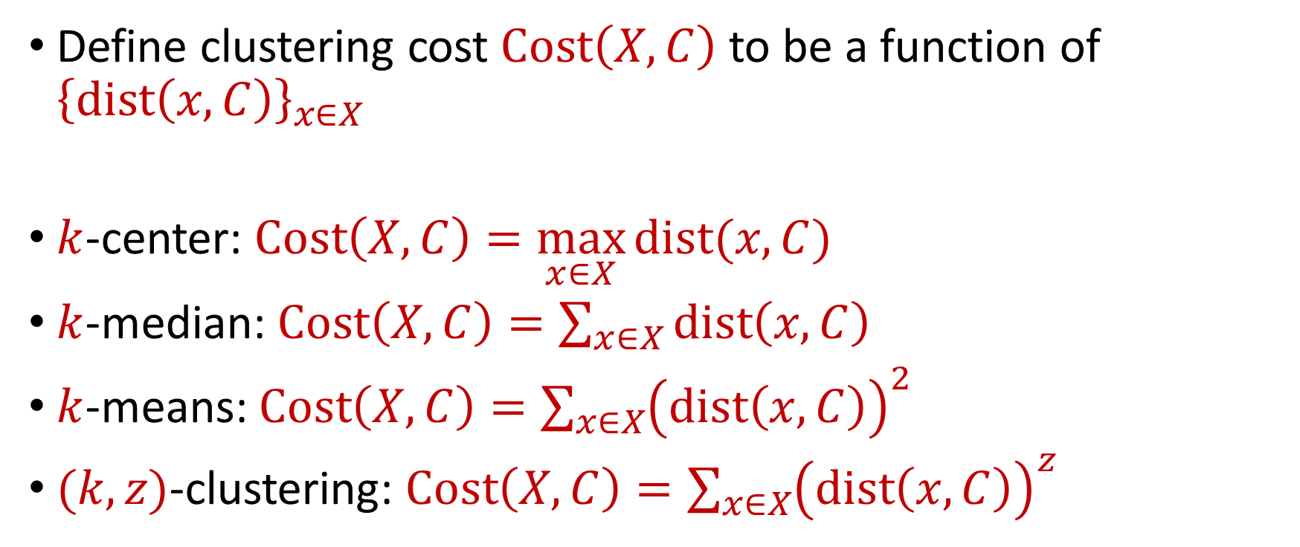






$k$-Clustering
Define clustering cost $Cost\left(X,C\right)$ to be a function of ${\left\{dist\left(x,C\right)\right\}}_{x∈X}$
$k$-center: $Cost\left(X,C\right)=\max_{x∈X}{dist(x,C)}$
$k$-median: $Cost\left(X,C\right)=\sum_{x∈X}{dist\left(x,C\right)}$
$k$-means: $Cost\left(X,C\right)=\sum_{x∈X}{{\left(dist\left(x,C\right)\right)}^{2}}$
$(k,z)$-clustering: $Cost\left(X,C\right)=\sum_{x∈X}{{\left(dist\left(x,C\right)\right)}^{z}}$
$${\left(⋅\right)}^{z}$$
$${\left(⋅\right)}^{z}$$
$${\left(⋅\right)}^{z}$$
$${\left(⋅\right)}^{z}$$
$${\left(⋅\right)}^{z}$$
$${\left(⋅\right)}^{z}$$
$${\left(⋅\right)}^{z}$$

Slide 13
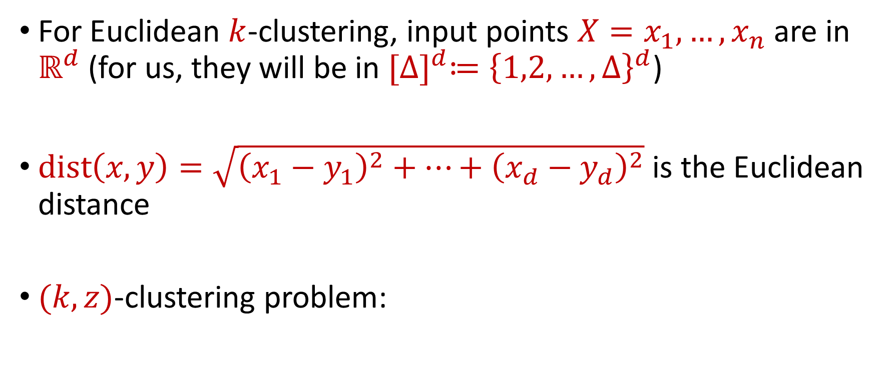


Euclidean $k$-Clustering
For Euclidean $k$-clustering, input points $X=x_{1},…,x_{n}$ are in $ℝ^{d}$ (for us, they will be in ${[Δ]}^{d}≔{\left\{1,2,…,Δ\right\}}^{d}$)
$dist\left(x,y\right)=\sqrt{{\left(x_{1}−y_{1}\right)}^{2}+…+{\left(x_{d}−y_{d}\right)}^{2}}$ is the Euclidean distance
$(k,z)$-clustering problem:
$$\min_{C:\left|C\right|≤k} Cost\left(X,C\right)=\min_{C:\left|C\right|≤k}{Σ_{x∈X}\left(dist\left(x,C\right)\right)}^{z}$$

Slide 14

The Streaming Model
Input: Updates to an underlying data set $X$ that arrive sequentially
Output: Evaluation (or approximation) of a given function
Goal: Use space sublinear in the size $n$of the input $X$

Slide 15
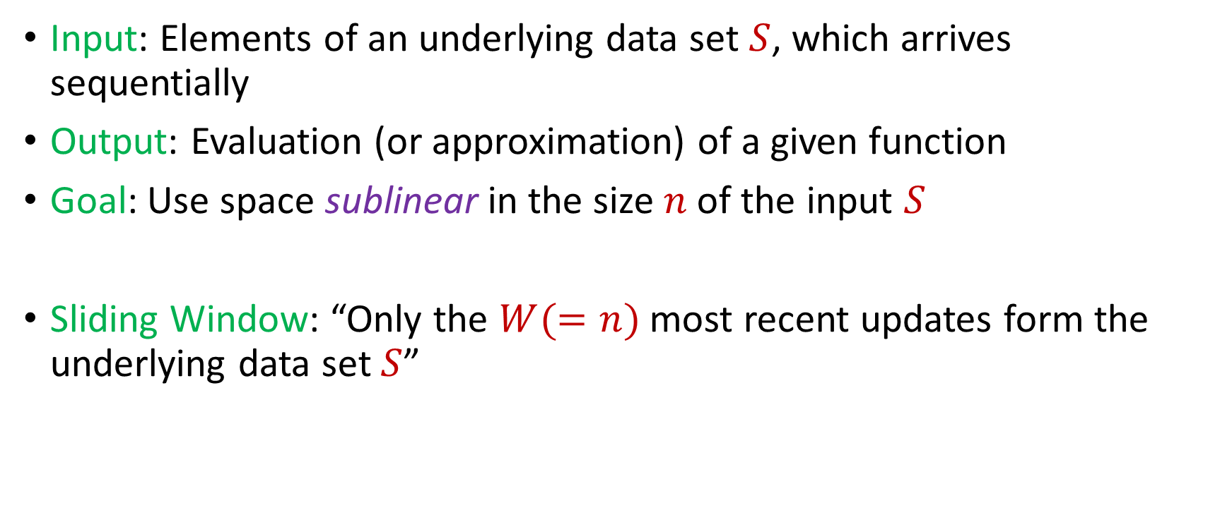
Streaming / Sliding Window Model
Input: Elements of an underlying data set $S$, which arrives sequentially
Output: Evaluation (or approximation) of a given function
Goal: Use space sublinear in the size $n$of the input $S$
Sliding Window: “Only the $W(=n)$ most recent updates form the underlying data set $S$”
1 0 1 1 1 0 0 1
Notes:
Let’s start by breaking down each of the terms in the title. To understand the sliding window model, we first have to understand the streaming model of computation, in which elements of an underlying data set S, arrive sequentially and the goal is to evaluate or approximate some given function on this dataset, using space sublinear in S. In the sliding window model, only the W most recent updates form the underlying data set

Slide 16
Streaming / Sliding Window Model
Input: Elements of an underlying data set $S$, which arrives sequentially
Output: Evaluation (or approximation) of a given function
Goal: Use space sublinear in the size $n$of the input $S$
Sliding Window: “Only the $W(=n)$ most recent updates form the underlying data set $S$”
1 0 1 1 1 0 0 1 1

Slide 17
Streaming / Sliding Window Model
Input: Elements of an underlying data set $S$, which arrives sequentially
Output: Evaluation (or approximation) of a given function
Goal: Use space sublinear in the size $n$of the input $S$
Sliding Window: “Only the $W(=n)$ most recent updates form the underlying data set $S$”
1 0 1 1 1 0 0 1 1 0

Slide 18
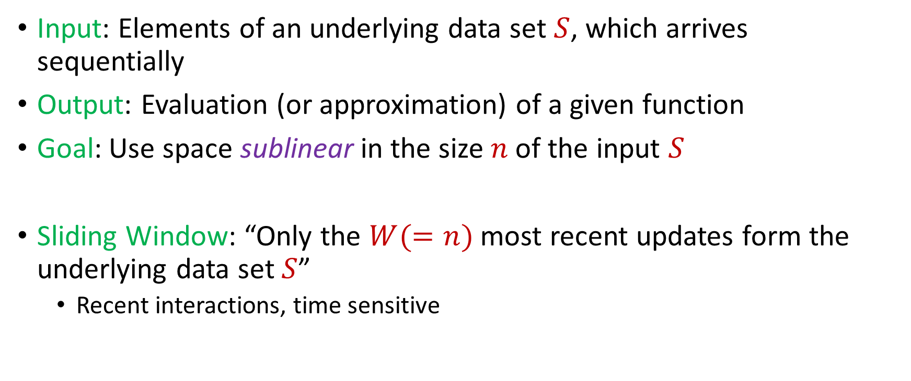
Streaming / Sliding Window Model
Input: Elements of an underlying data set $S$, which arrives sequentially
Output: Evaluation (or approximation) of a given function
Goal: Use space sublinear in the size $n$of the input $S$
Sliding Window: “Only the $W(=n)$ most recent updates form the underlying data set $S$”
Recent interactions, time sensitive
1 0 1 1 1 0 0 1 1 0 1
Notes:
The sliding window model emphasizes recent data and thus is appropriate for settings that are time sensitive.

Slide 19




Sliding Window Model
Consumer analytics: Consumer patterns may be sensitive to temporal trends or seasonal shifts
Notes:
The sliding window model emphasizes recent data and thus is appropriate for settings that are time sensitive.

Slide 20



Sliding Window Model
Data retention policy: the Facebook data policy says user search histories are stored for 6 months, the Apple differential privacy overview says collected user information is retained for 3 months, and the Google data retention policy states that browser information may be stored for up 9 months
Notes:
The sliding window model emphasizes recent data and thus is appropriate for settings that are time sensitive.

Slide 21

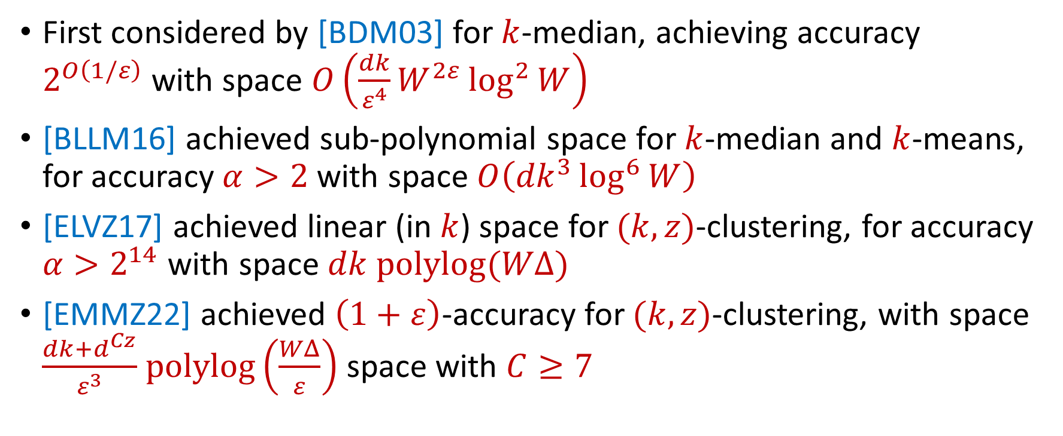
$k$-Clustering in the Sliding Window Model
First considered by [BDM03] for $k$-median, achieving accuracy $2^{O\left(1/ε\right)}$with space $O\left(\frac{dk}{ε^{4}}W^{2ε}\log^{2}{W}\right)$
[BLLM16] achieved sub-polynomial space for $k$-median and $k$-means, for accuracy $α>2$ with space $O\left({dk}^{3}\log^{6}{W}\right)$
[ELVZ17] achieved linear (in $k$) space for $(k,z)$-clustering, for accuracy $α>2^{14}$ with space $dk polylog(WΔ)$
[EMMZ22] achieved $\left(1+ε\right)$-accuracy for $(k,z)$-clustering, with space $\frac{dk+d^{Cz}}{ε^{3}}$ $polylog\left(\frac{WΔ}{ε}\right)$ space with $C≥7$
Notes:
The sliding window model emphasizes recent data and thus is appropriate for settings that are time sensitive.

Slide 22
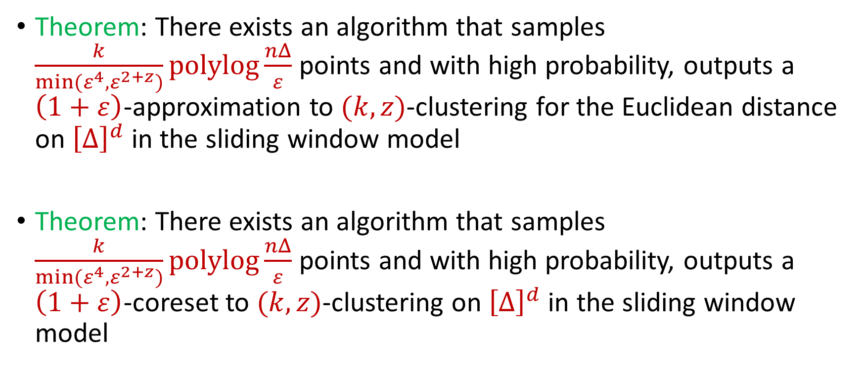
Our Results
Theorem: There exists an algorithm that samples $\frac{k}{min(ε^{4},ε^{2+z})}polylog\frac{nΔ}{ε}$ points and with high probability, outputs a $\left(1+ε\right)$-approximation to $(k,z)$-clustering for the Euclidean distance on ${\left[Δ\right]}^{d}$ in the sliding window model
Theorem: There exists an algorithm that samples $\frac{k}{min(ε^{4},ε^{2+z})}polylog\frac{nΔ}{ε}$ points and with high probability, outputs a $\left(1+ε\right)$-coreset to $(k,z)$-clustering on ${\left[Δ\right]}^{d}$ in the sliding window model
Notes:
The sliding window model emphasizes recent data and thus is appropriate for settings that are time sensitive.

Slide 23
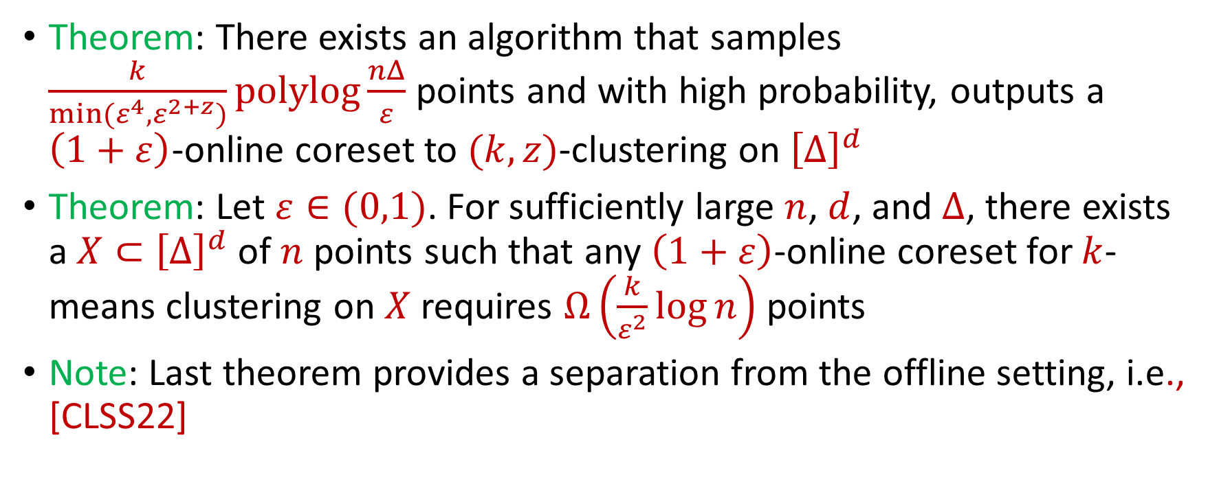
Our Results
Theorem: There exists an algorithm that samples $\frac{k}{min(ε^{4},ε^{2+z})}polylog\frac{nΔ}{ε}$ points and with high probability, outputs a $\left(1+ε\right)$-online coreset to $(k,z)$-clustering on ${\left[Δ\right]}^{d}$
Theorem: Let $ε∈(0,1)$. For sufficiently large $n$, $d$, and $Δ$, there exists a $X⊂{\left[Δ\right]}^{d}$ of $n$ points such that any $\left(1+ε\right)$-online coreset for $k$-means clustering on $X$ requires $Ω\left(\frac{k}{ε^{2}}\log{n}\right)$ points
Note: Last theorem provides a separation from the offline setting, i.e., [CLSS22]
Notes:
The sliding window model emphasizes recent data and thus is appropriate for settings that are time sensitive.

Slide 24
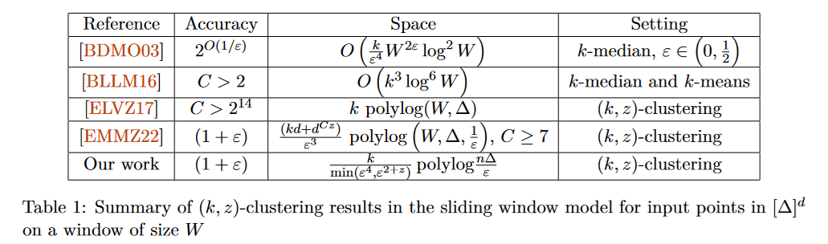
$k$-Clustering in the Sliding Window Model
Notes:
The sliding window model emphasizes recent data and thus is appropriate for settings that are time sensitive.

Slide 25

Questions?
Format
Part 1: Background
Part 2: Sliding Window Model
Part 3: Merge-and-Reduce for the Sliding Window Model
Part 4: Online Coreset Construction

Slide 26
Sliding Window Model and Linear Sketches
Can we use linear sketches for the sliding window model?
Notes:
The sliding window model emphasizes recent data and thus is appropriate for settings that are time sensitive.

Slide 27
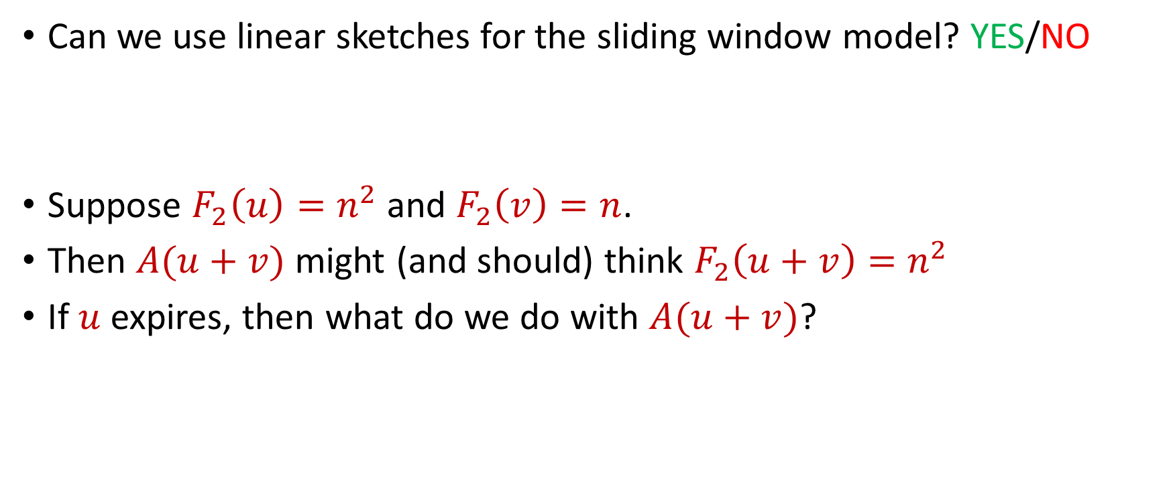


Sliding Window Model and Linear Sketches
Can we use linear sketches for the sliding window model? YES/NO
Suppose $F_{2}\left(u\right)=n^{2}$ and $F_{2}\left(v\right)=n$.
Then $A(u+v)$ might (and should) think $F_{2}\left(u+v\right)=n^{2}$
If $u$ expires, then what do we do with $A(u+v)$?
1 1 1 1 1 1 1 1 1 1 1 2 3 4 5 6 7 8 9 10 11
$$u$$
$$v$$
Notes:
The sliding window model emphasizes recent data and thus is appropriate for settings that are time sensitive.

Slide 28
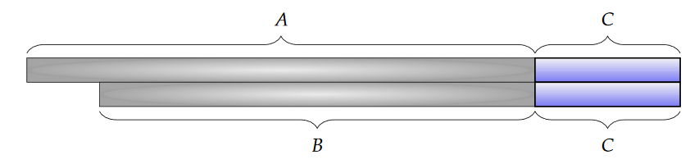
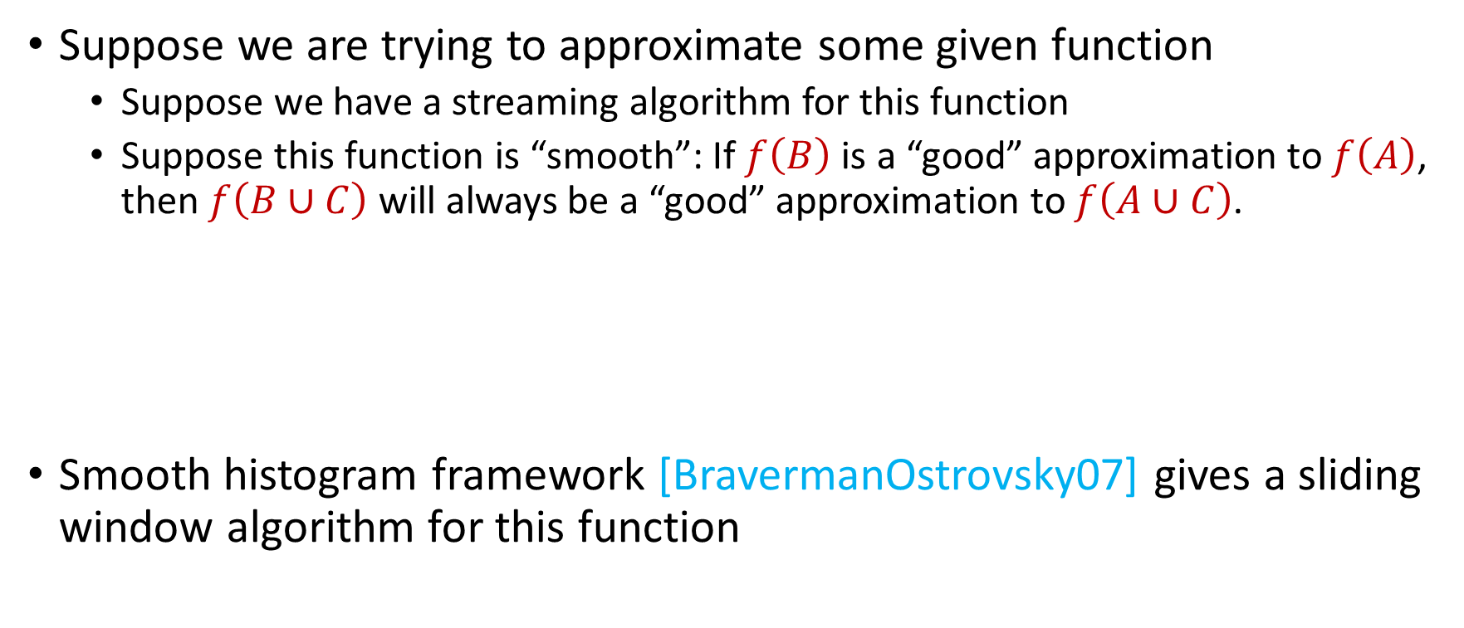
Sliding Window Algorithms
Suppose we are trying to approximate some given function
Suppose we have a streaming algorithm for this function
Suppose this function is “smooth”: If $f\left(B\right)$ is a “good” approximation to $f\left(A\right)$, then $f\left(B∪C\right)$ will always be a “good” approximation to $f\left(A∪C\right)$.
Smooth histogram framework [BravermanOstrovsky07] gives a sliding window algorithm for this function

Slide 29
Smooth Histogram
Suppose we are trying to approximate some given function
Smooth histogram framework [BO07] gives a sliding window algorithm for this function
Start a new instance of the streaming algorithm (along with existing instances) each time a new element arrives
Each time there are three instances that report “close” values, delete the middle one
Use different checkpoints to “sandwich” the sliding window

Slide 30
Smooth Histogram
Start a new instance of the streaming algorithm (along with existing instances) each time a new element arrives
Each time there are three instances that report “close” values, delete the middle one
Use different checkpoints to “sandwich” the sliding window
1
Example: Number of ones in sliding window (2-approximation)
1

Slide 31
Smooth Histogram
Start a new instance of the streaming algorithm (along with existing instances) each time a new element arrives
Each time there are three instances that report “close” values, delete the middle one
Use different checkpoints to “sandwich” the sliding window
1 0
Example: Number of ones in sliding window (2-approximation)
1
0

Slide 32
Smooth Histogram
Start a new instance of the streaming algorithm (along with existing instances) each time a new element arrives
Each time there are three instances that report “close” values, delete the middle one
Use different checkpoints to “sandwich” the sliding window
1 0 1
Example: Number of ones in sliding window (2-approximation)
2
1
1

Slide 33
Smooth Histogram
Start a new instance of the streaming algorithm (along with existing instances) each time a new element arrives
Each time there are three instances that report “close” values, delete the middle one
Use different checkpoints to “sandwich” the sliding window
1 0 1
Example: Number of ones in sliding window (2-approximation)
2
1

Slide 34
Smooth Histogram
Start a new instance of the streaming algorithm (along with existing instances) each time a new element arrives
Each time there are three instances that report “close” values, delete the middle one
Use different checkpoints to “sandwich” the sliding window
1 0 1
Example: Number of ones in sliding window (2-approximation)
2
1

Slide 35
Smooth Histogram
Start a new instance of the streaming algorithm (along with existing instances) each time a new element arrives
Each time there are three instances that report “close” values, delete the middle one
Use different checkpoints to “sandwich” the sliding window
1 0 1 1
Example: Number of ones in sliding window (2-approximation)
3
2
1

Slide 36
Smooth Histogram
Start a new instance of the streaming algorithm (along with existing instances) each time a new element arrives
Each time there are three instances that report “close” values, delete the middle one
Use different checkpoints to “sandwich” the sliding window
1 0 1 1 1
Example: Number of ones in sliding window (2-approximation)
4
3
2
1

Slide 37
Smooth Histogram
Start a new instance of the streaming algorithm (along with existing instances) each time a new element arrives
Each time there are three instances that report “close” values, delete the middle one
Use different checkpoints to “sandwich” the sliding window
1 0 1 1 1
Example: Number of ones in sliding window (2-approximation)
4
2
1

Slide 38
Smooth Histogram
Start a new instance of the streaming algorithm (along with existing instances) each time a new element arrives
Each time there are three instances that report “close” values, delete the middle one
Use different checkpoints to “sandwich” the sliding window
1 0 1 1 1 0 0 1 1 0 1
Example: Number of ones in sliding window (2-approximation)
7
4
2
1

Slide 39
Smooth Histogram
Start a new instance of the streaming algorithm (along with existing instances) each time a new element arrives
Each time there are three instances that report “close” values, delete the middle one
Use different checkpoints to “sandwich” the sliding window
1 0 1 1 1 0 0 1 1 0 1
Example: Number of ones in sliding window (2-approximation)
Number of ones in sliding window is at least 4 and at most 7
4 is a good approximation
7
4
2
1

Slide 40
Smooth Histogram
Converts a streaming algorithm for a smooth function into a sliding window algorithm
…Unfortunately, clustering is not smooth…

Slide 41
Questions?
Format
Part 1: Background
Part 2: Sliding Window Model
Part 3: Merge-and-Reduce for the Sliding Window Model
Part 4: Online Coreset Construction

Slide 42
Coreset
Subset $X′$ of representative points of $X$ for a specific clustering objective
$Cost\left(X,C\right)≈Cost(X^{′},C)$ for all sets $C$ with $\left|C\right|=k$

Slide 43
Coreset
Subset $X′$ of representative points of $X$ for a specific clustering objective
$Cost\left(X,C\right)≈Cost(X^{′},C)$ for all sets $C$ with $\left|C\right|=k$

Slide 44
Coreset
Subset $X′$ of representative points of $X$ for a specific clustering objective
$Cost\left(X,C\right)≈Cost(X^{′},C)$ for all sets $C$ with $\left|C\right|=k$

Slide 45
Coreset (Formal Definition)
Given a set $X$ and an accuracy parameter $ε>0$, we say a set $X′$ with weight function $w$is an $(1+ε)$-multiplicative coreset for a cost function $Cost$, if for all queries $C$ with $\left|C\right|≤k$, we have
$$\left(1−ε\right)Cost(X,C)≤Cost(X′,C,w)≤\left(1+ε\right)Cost(X,C)$$
$(k,z)$-clustering: $Cost\left(X^{′},C,w\right)=\sum_{x∈X′}{{w\left(x\right)⋅\left(dist\left(x,C\right)\right)}^{z}}$

Slide 46
Coreset (Formal Definition)
Given a set $X$ and an accuracy parameter $ε>0$, we say a set $X′$ with weight function $w$is an $(1+ε)$-multiplicative coreset for a cost function $Cost$, if for all queries $C$ with $\left|C\right|≤k$, we have
$$\left(1−ε\right)Cost(X,C)≤Cost(X′,C,w)≤\left(1+ε\right)Cost(X,C)$$
$(k,z)$-clustering: $Cost\left(X^{′},C,w\right)=\sum_{x∈X′}{{w\left(x\right)⋅\left(dist\left(x,C\right)\right)}^{z}}$

Slide 47
$(k,z)$-Clustering in the Streaming Model
Merge-and-reduce framework
Suppose there exists a $(1+ε)$-coreset construction for $(k,z)$-clustering that uses $f\left(k,\frac{1}{ε}\right)$ weighted input points
Partition the stream into blocks containing $f\left(k,\frac{\log{n}}{ε}\right)$ points
$$\tilde{O}\left(\frac{k^{2}}{ε^{2}}\right)$$

Slide 48
$(k,z)$-Clustering in the Streaming Model
Partition the stream into blocks containing $f\left(k,\frac{\log{n}}{ε}\right)$ points
Create a $\left(1+\frac{ε}{\log{n}}\right)$-coreset for each block
Create a $\left(1+\frac{ε}{\log{n}}\right)$-coreset for the set of points formed by the union of two coresets for each block
Reduce
Merge

Slide 49
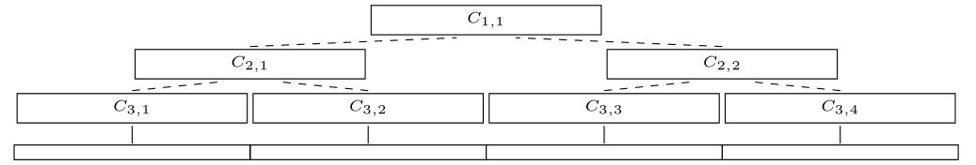
$(k,z)$-Clustering in the Streaming Model
Partition the stream into blocks containing $f\left(k,\frac{\log{n}}{ε}\right)$ points
Create a $\left(1+\frac{ε}{\log{n}}\right)$-coreset for each block
Create a $\left(1+\frac{ε}{\log{n}}\right)$-coreset for the set of points formed by the union of two coresets for each block

Slide 50
$(k,z)$-Clustering in the Streaming Model
There are $O\left(log n\right)$ levels
Each coreset is a $\left(1+\frac{ε}{\log{n}}\right)$-coreset of two coresets
Total approximation is ${\left(1+\frac{ε}{\log{n}}\right)}^{\log{n}}=(1+O\left(ε\right))$

Slide 51
$(k,z)$-Clustering in the Streaming Model
Suppose there exists a $(1+ε)$-coreset construction for $(k,z)$-clustering that uses $f\left(k,\frac{1}{ε}\right)$ weighted input points
Partition the stream into blocks containing $f\left(k,\frac{\log{n}}{ε}\right)$ points
Total space is $f\left(k,\frac{\log{n}}{ε}\right)⋅O(log{n)}$ points
For $k$-means clustering, this is $\tilde{O}\left(\frac{k^{2}}{ε^{2}}⋅\log^{3}{n}\right)$ points

Slide 52
Online Coreset
Coreset: Data structure approximately preserves the cost of the data set
Online coreset: Data set now has an arrival order, and data structure approximately preserves the cost of all prefixes of the data stream

Slide 53
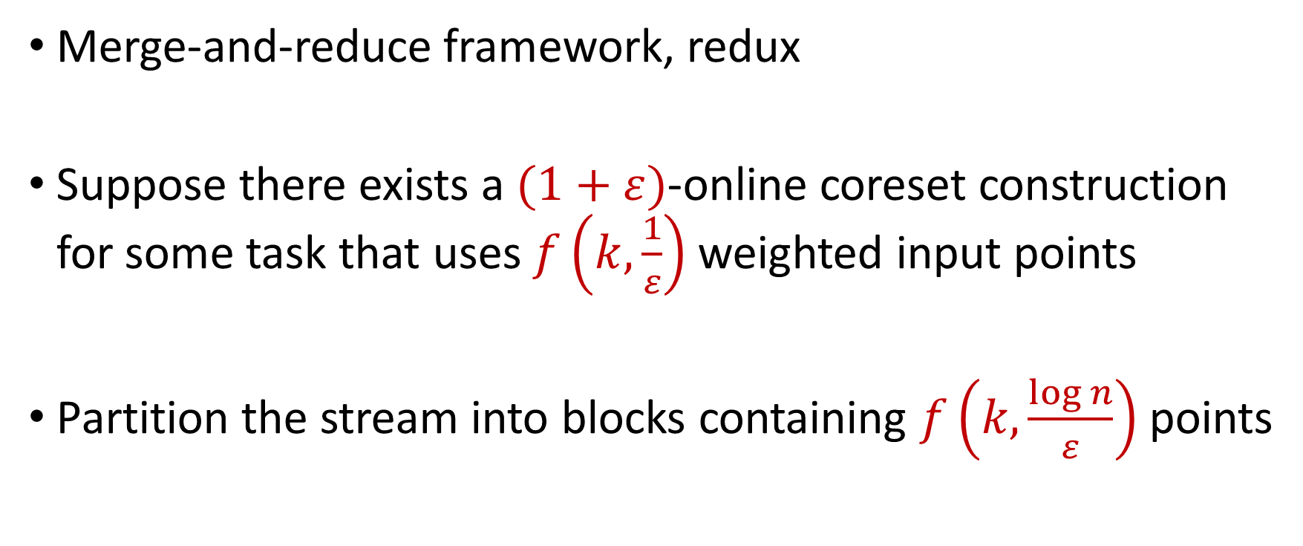
Online Coreset to Sliding Window Model
Merge-and-reduce framework, redux
Suppose there exists a $(1+ε)$-online coreset construction for some task that uses $f\left(k,\frac{1}{ε}\right)$ weighted input points
Partition the stream into blocks containing $f\left(k,\frac{\log{n}}{ε}\right)$ points

Slide 54
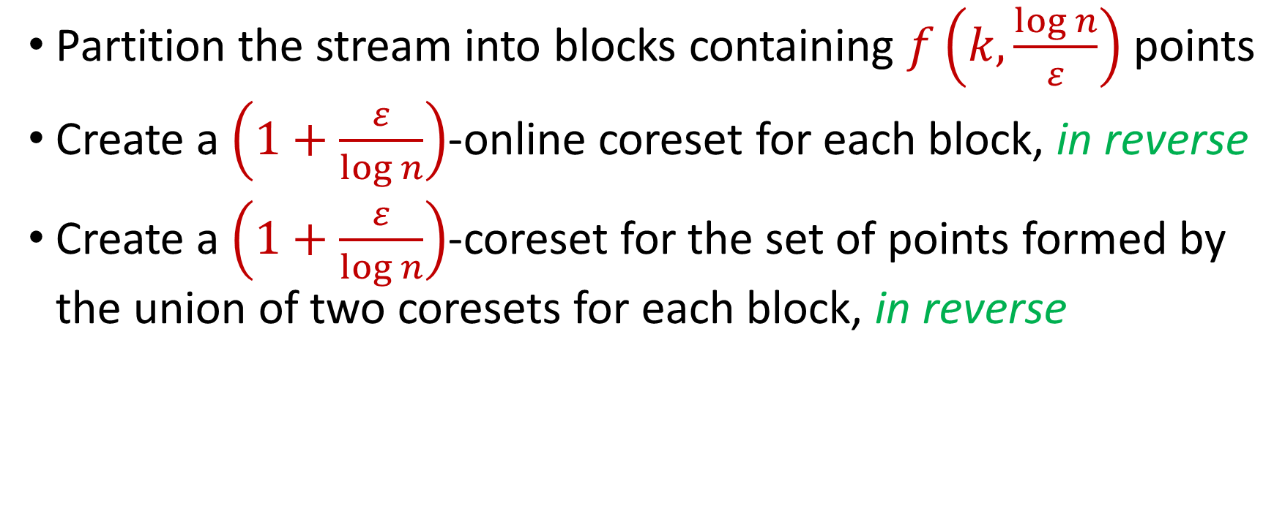
Online Coreset to Sliding Window Model
Partition the stream into blocks containing $f\left(k,\frac{\log{n}}{ε}\right)$ points
Create a $\left(1+\frac{ε}{\log{n}}\right)$-online coreset for each block, in reverse
Create a $\left(1+\frac{ε}{\log{n}}\right)$-coreset for the set of points formed by the union of two coresets for each block, in reverse
Reduce
Merge

Slide 55
Online Coreset to Sliding Window Model
Partition the stream into blocks containing $f\left(k,\frac{\log{n}}{ε}\right)$ points
Create a $\left(1+\frac{ε}{\log{n}}\right)$-online coreset for each block, in reverse
Create a $\left(1+\frac{ε}{\log{n}}\right)$-coreset for the set of points formed by the union of two coresets for each block, in reverse

Slide 56
Online Coreset to Sliding Window Model
There are $O\left(log n\right)$ levels
Each coreset is a $\left(1+\frac{ε}{\log{n}}\right)$-coreset of two coresets
Total approximation is ${\left(1+\frac{ε}{\log{n}}\right)}^{\log{n}}=(1+O\left(ε\right))$

Slide 57
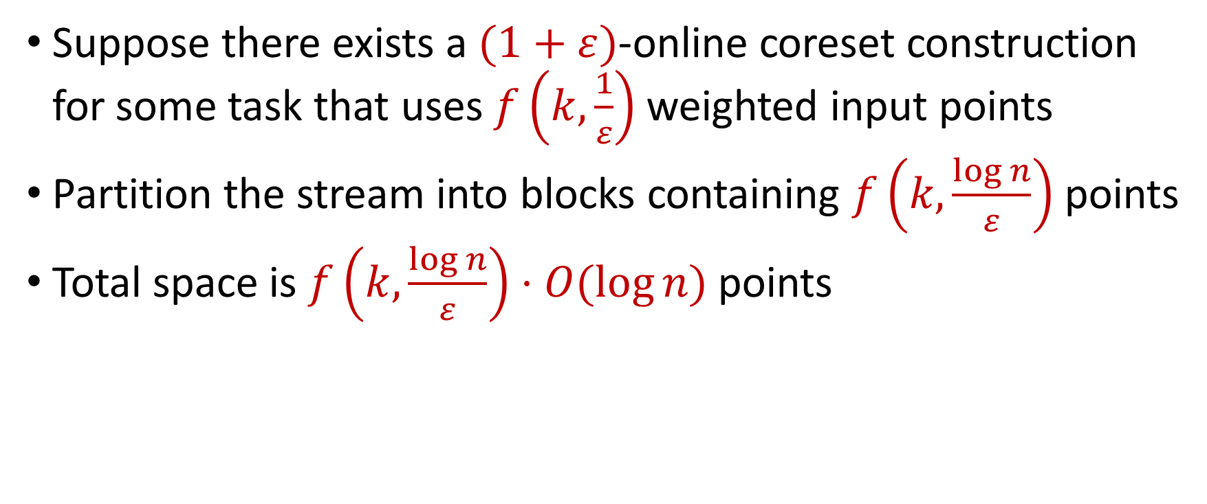
Online Coreset to Sliding Window Model
Suppose there exists a $(1+ε)$-online coreset construction for some task that uses $f\left(k,\frac{1}{ε}\right)$ weighted input points
Partition the stream into blocks containing $f\left(k,\frac{\log{n}}{ε}\right)$ points
Total space is $f\left(k,\frac{\log{n}}{ε}\right)⋅O(log{n)}$ points

Slide 58
Questions?
Format
Part 1: Background
Part 2: Sliding Window Model
Part 3: Merge-and-Reduce for the Sliding Window Model
Part 4: Online Coreset Construction

Slide 59

Coreset Construction and Sampling
Consider a fixed set $X$ and a fixed set $C$ of $k$ centers, which induces a fixed cost $Cost(X,C)$

Slide 60

Coreset Construction and Sampling
Consider a fixed set $X$ and a fixed set $C$ of $k$ centers, which induces a fixed cost $Cost(X,C)$
A simple way to obtain $X′$with $Cost\left(X^{′},C\right)≈Cost(X,C)$ is to uniformly sample points of $X$ into $X′$

Slide 61

Coreset Construction and Uniform Sampling
Consider a fixed set $X$ and a fixed set $C$ of $k$ centers, which induces a fixed cost $Cost\left(X,C\right)$
Suppose all points have cost between $1$ and $100$
Suppose $p_{i}=p$ for all $i∈[n]$

Slide 62
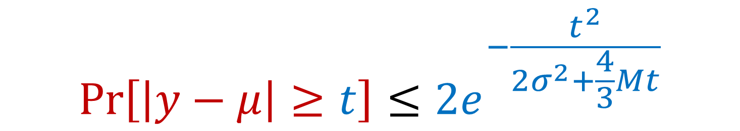

Bernstein’s Inequality
Bernstein’s inequality: Let $y_{1},…,y_{n}∈[−M,M]$ be independent random variables and let ${y=y}_{1}+…+y_{n}$ have mean $μ$ and variance $σ^{2}$. Then for any $t≥0$:
$$Pr\left[\left|y−μ\right|≥t\right]≤2e^{−\frac{t^{2}}{2σ^{2}+\frac{4}{3}Mt}}$$

Slide 63
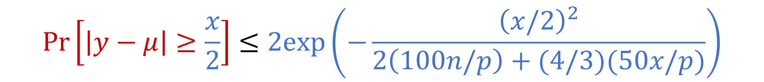

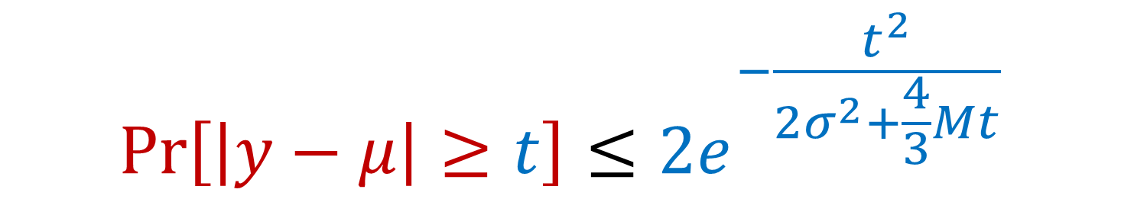
Bernstein’s Inequality
Bernstein’s inequality: Let $y_{1},…,y_{n}∈[−M,M]$ be independent random variables and let ${y=y}_{1}+…+y_{n}$ have mean $μ$ and variance $σ^{2}$. Then for any $t≥0$:
Set $M=\frac{100}{p}$ , $t=\frac{1}{2}⋅Cost\left(X,C\right)$, and $σ^{2}≈\frac{10000n}{p}$. Then for $x=Cost\left(X,C\right)$,
$$Pr\left[\left|y−μ\right|≥t\right]≤2e^{−\frac{t^{2}}{2σ^{2}+\frac{4}{3}Mt}}$$
$$Pr\left[\left|y−μ\right|≥\frac{x}{2}\right]≤2exp\left(−\frac{{\left(x/2\right)}^{2}}{2\left(100n/p\right)+(4/3)(50x/p)}\right)$$

Slide 64
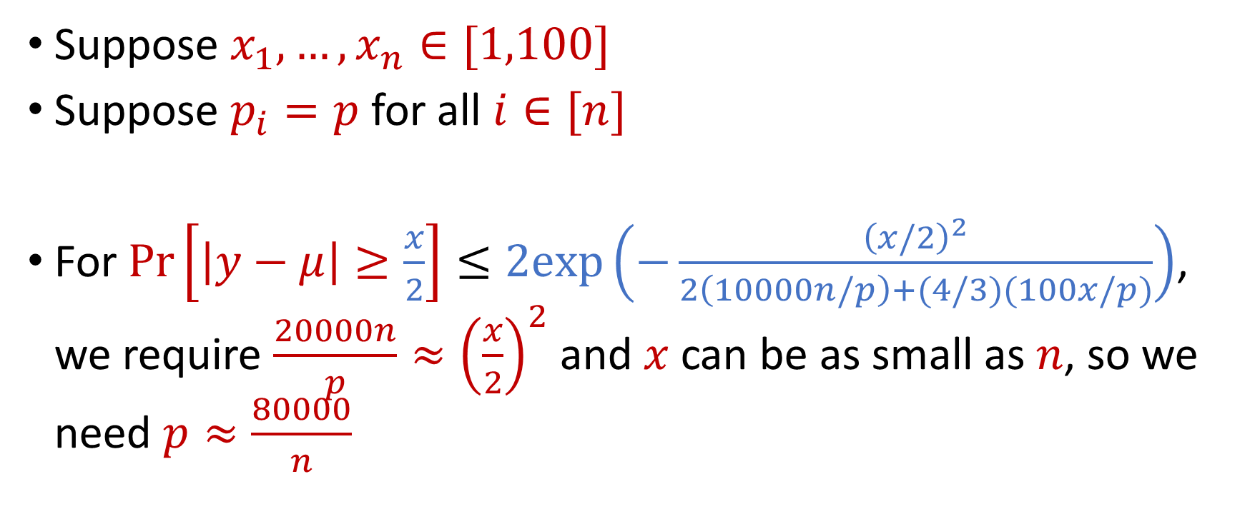
Coreset Construction and Uniform Sampling
Suppose $x_{1},…,x_{n}∈[1,100]$
Suppose $p_{i}=p$ for all $i∈[n]$
For $Pr\left[\left|y−μ\right|≥\frac{x}{2}\right]≤2exp\left(−\frac{{\left(x/2\right)}^{2}}{2\left(10000n/p\right)+(4/3)(100x/p)}\right)$, we require $\frac{20000n}{p}≈{\left(\frac{x}{2}\right)}^{2}$ and $x$ can be as small as $n$, so we need $p≈\frac{80000}{n}$

Slide 65
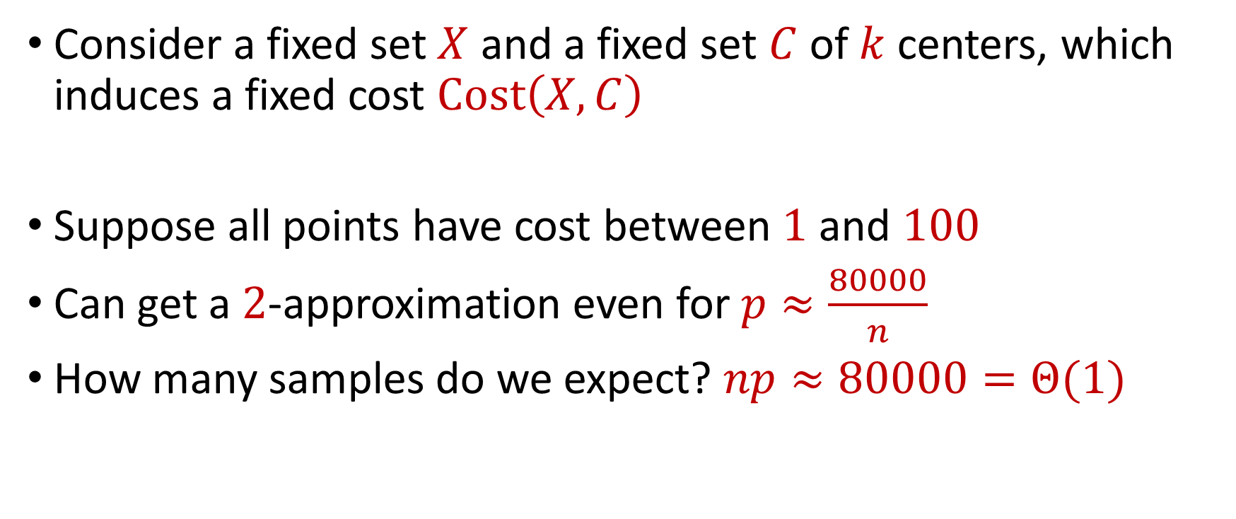
Coreset Construction and Uniform Sampling
Consider a fixed set $X$ and a fixed set $C$ of $k$ centers, which induces a fixed cost $Cost\left(X,C\right)$
Suppose all points have cost between $1$ and $100$
Can get a $2$-approximation even for $p≈\frac{80000}{n}$
How many samples do we expect? $np≈80000=Θ(1)$

Slide 66

Coreset Construction and Sampling
Consider a fixed set $X$ and a fixed set $C$ of $k$ centers, which induces a fixed cost $Cost(X,C)$
Uniform sampling needs a lot of samples if there is a single point that greatly contributes to $Cost(X,C)$

Slide 67

Coreset Construction and Sampling
Fix: Importance sampling, sample each point $x∈X$ into $X′$ with probability proportional $Cost(x,C)$, i.e., $Cost(x,C)/Cost(X,C)$

Slide 68
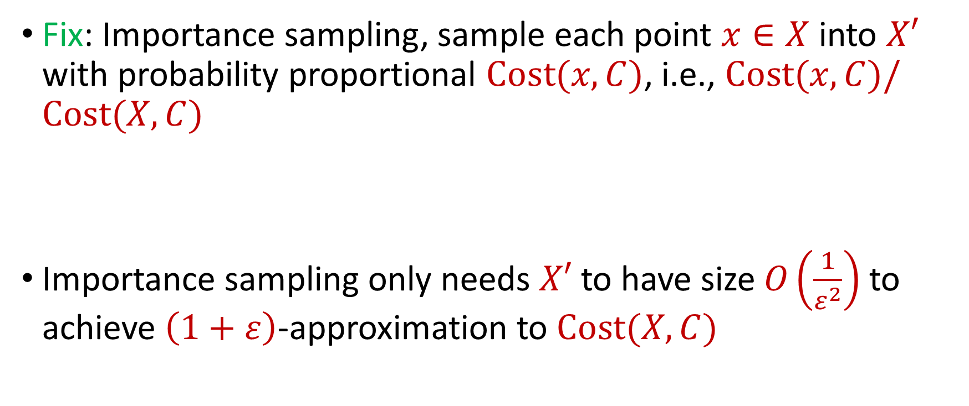
Coreset Construction and Sampling
Fix: Importance sampling, sample each point $x∈X$ into $X′$ with probability proportional $Cost(x,C)$, i.e., $Cost(x,C)/Cost(X,C)$
Importance sampling only needs $X′$ to have size $O\left(\frac{1}{ε^{2}}\right)$ to achieve $\left(1+ε\right)$-approximation to $Cost(X,C)$

Slide 69

Coreset Construction and Sampling
Importance sampling only needs $X′$ to have size $O\left(\frac{1}{ε^{2}}\right)$ to achieve $\left(1+ε\right)$-approximation to $Cost(X,C)$
What about a different choice $C$ of $k$ centers?

Slide 70
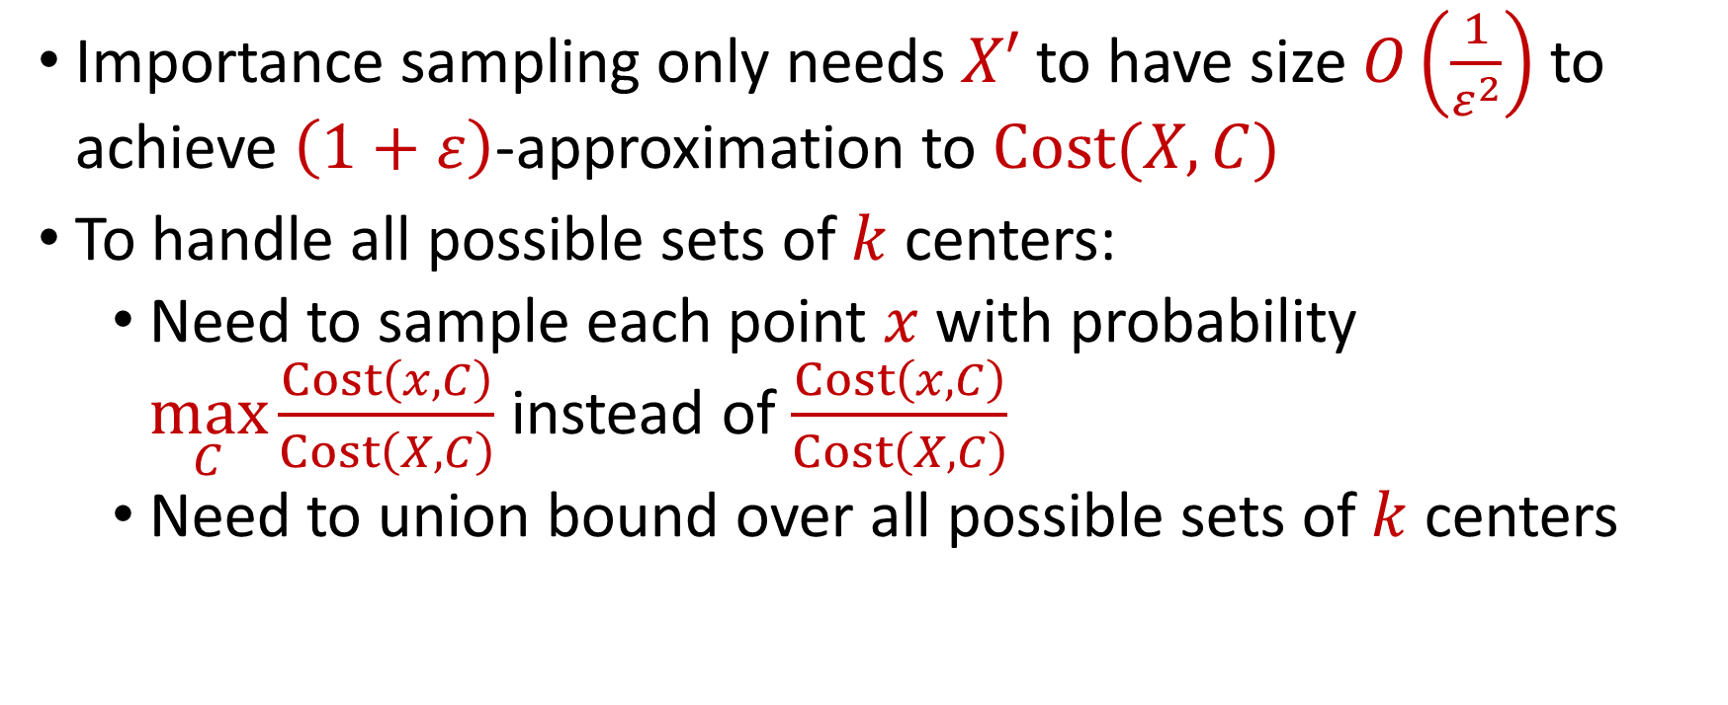
Coreset Construction and Sampling
Importance sampling only needs $X′$ to have size $O\left(\frac{1}{ε^{2}}\right)$ to achieve $\left(1+ε\right)$-approximation to $Cost(X,C)$
To handle all possible sets of $k$ centers:
Need to sample each point $x$ with probability $\max_{C}\frac{Cost\left(x,C\right)}{Cost\left(X,C\right)}$ instead of $\frac{Cost\left(x,C\right)}{Cost\left(X,C\right)}$
Need to union bound over all possible sets of $k$ centers
???

Slide 71

Nets
A net $N$ is a set of sets $C$ of $k$ centers such that accuracy on $N$ implies accuracy everywhere

Slide 72
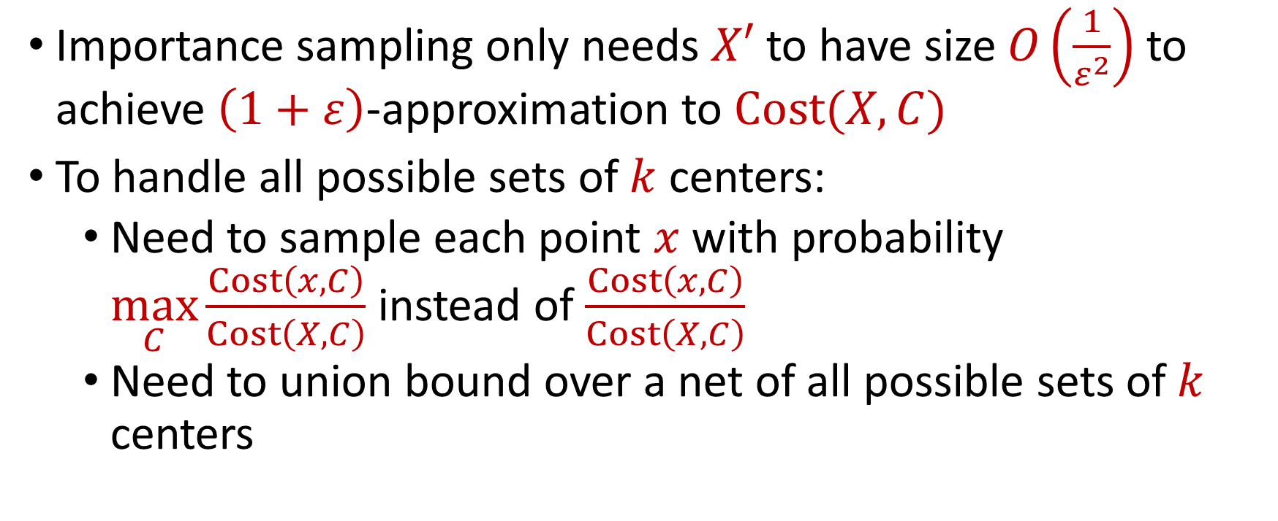

Coreset Construction and Sampling
Importance sampling only needs $X′$ to have size $O\left(\frac{1}{ε^{2}}\right)$ to achieve $\left(1+ε\right)$-approximation to $Cost(X,C)$
To handle all possible sets of $k$ centers:
Need to sample each point $x$ with probability $\max_{C}\frac{Cost\left(x,C\right)}{Cost\left(X,C\right)}$ instead of $\frac{Cost\left(x,C\right)}{Cost\left(X,C\right)}$
Need to union bound over a net of all possible sets of $k$ centers
Net with size ${\left(\frac{nΔ}{ε}\right)}^{O(kd)}$

Slide 73
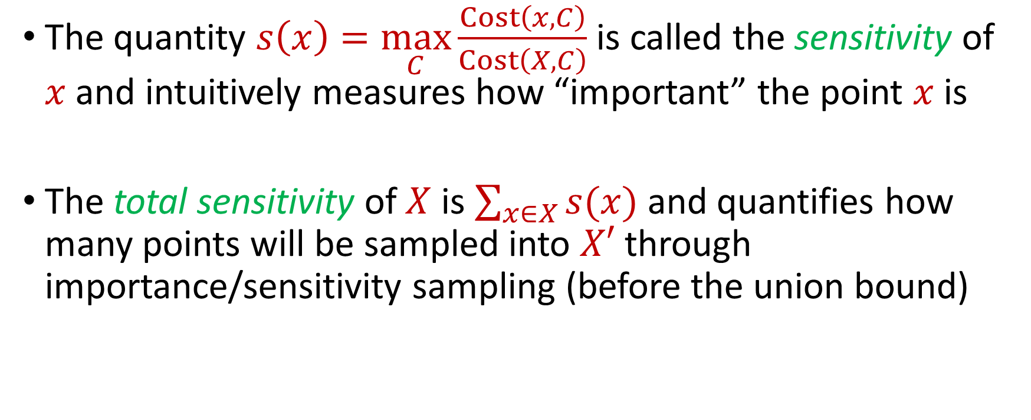
Sensitivity Sampling
The quantity $s\left(x\right)=\max_{C}\frac{Cost\left(x,C\right)}{Cost\left(X,C\right)}$ is called the sensitivity of $x$ and intuitively measures how “important” the point $x$ is
The total sensitivity of $X$ is $\sum_{x∈X}{s(x)}$ and quantifies how many points will be sampled into $X′$ through importance/sensitivity sampling (before the union bound)

Slide 74
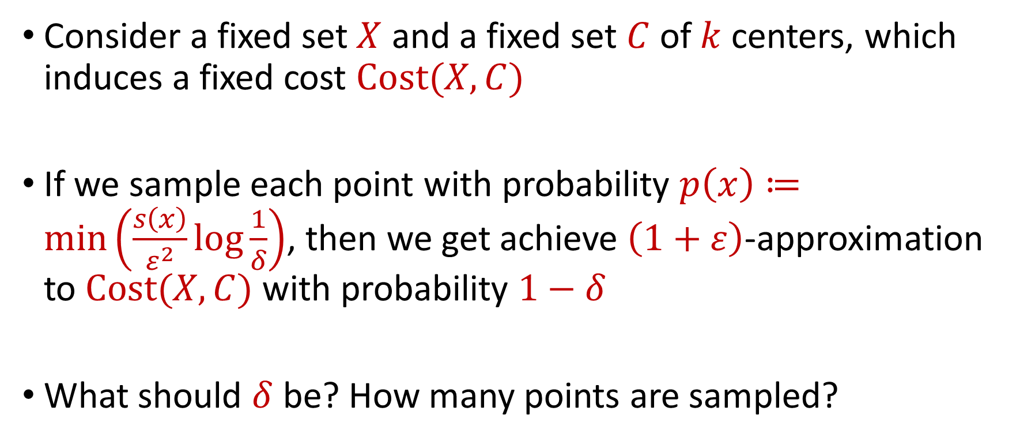
Sensitivity Sampling
Consider a fixed set $X$ and a fixed set $C$ of $k$ centers, which induces a fixed cost $Cost(X,C)$
If we sample each point with probability $p\left(x\right)≔\min\left(\frac{s\left(x\right)}{ε^{2}}log\frac{1}{δ}\right)$, then we get achieve $\left(1+ε\right)$-approximation to $Cost(X,C)$ with probability $1−δ$
What should $δ$ be? How many points are sampled?

Slide 75
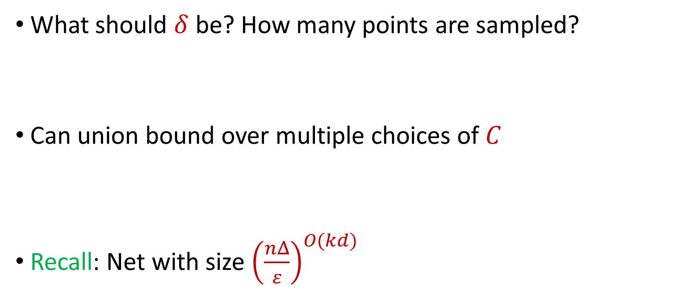
Sensitivity Sampling
What should $δ$ be? How many points are sampled?
Can union bound over multiple choices of $C$
Recall: Net with size ${\left(\frac{nΔ}{ε}\right)}^{O(kd)}$

Slide 76

Sensitivity Sampling
Recall: Net with size ${\left(\frac{nΔ}{ε}\right)}^{O(kd)}$
Correctness on net implies correctness everywhere, so we set $δ=\frac{1}{100}⋅{\left(\frac{ε}{nΔ}\right)}^{O(kd)}$ and by a union bound, our algorithm succeeds with probability $0.99$
$\log{\frac{1}{δ}}=kd⋅\log{\frac{nΔ}{ε}}$

Slide 77

Sensitivity Sampling
$p\left(x\right)≔\min\left(\frac{s\left(x\right)}{ε^{2}}log\frac{1}{δ}\right)$, so we sample $\sum_{x∈X}{p(x)}$ points in expectation
At most $\frac{1}{ε^{2}}log\frac{1}{δ}\sum_{x∈X}{s(x)}$ points in total
Since $\log{\frac{1}{δ}}=kd⋅\log{\frac{nΔ}{ε}}$, then $\frac{kd}{ε^{2}}⋅\log{\frac{nΔ}{ε}}⋅\sum_{x∈X}{s(x)}$ points
What is $\sum_{x∈X}{s(x)}$? Total sensitivity!

Slide 78

Sensitivity Sampling
Since $\log{\frac{1}{δ}}=kd⋅\log{\frac{nΔ}{ε}}$, then $\frac{kd}{ε^{2}}⋅\log{\frac{nΔ}{ε}}⋅\sum_{x∈X}{s(x)}$ points
What is $\sum_{x∈X}{s(x)}$? Total sensitivity!
$\sum_{x∈X}{s(x)}=O_{z}(k)$
In total, roughly $\frac{k^{2}d}{ε^{2}}⋅\log{\frac{nΔ}{ε}}$ points sampled in expectation
Sensitivity sampling produces a $\left(1+ε\right)$-coreset for $X$

Slide 79

Online Sensitivity
In a data stream, computing/approximating sensitivity $s\left(x\right)=\max_{C}\frac{Cost\left(x,C\right)}{Cost\left(X,C\right)}$ requires seeing the entire dataset $X$, but then it is too late to sample $x$
We define the online sensitivity of $x_{t}$ with respect to a stream $x_{1},…,x_{n}$ to be $φ\left(x_{t}\right)=\max_{C}\frac{Cost\left(x_{t},C\right)}{Cost\left(X_{t},C\right)}$, where $X_{t}=x_{1},…,x_{t}$, which intuitively measures how “important” the point $x$ is SO FAR

Slide 80

Online Sensitivity
Streaming algorithm: sample each point $x_{t}$ with probability $p\left(x_{t}\right)=\min\left(1,\frac{kd}{ε^{2}}⋅polylog\left(nΔ\right)⋅φ(x_{t})\right)$
How to compute (or approximate) $φ(x_{t})$?

Slide 81

Online Sensitivity
Observation: we can use a $\left(1+ε\right)$-coreset to obtain a $\left(1+ε\right)$-approximation to $φ\left(x_{t}\right)$
Use samples obtained from online sensitivity sampling at each time $t−1$ to obtain a $\left(1+ε\right)$-approximation to $φ\left(x_{t}\right)$
Can then perform online sensitivity sampling at time $t$ and by induction, at all times in the stream

Slide 82

Online Sensitivity
Streaming algorithm: sample each point $x_{t}$ with probability $p\left(x_{t}\right)=\min\left(1,\frac{kd}{ε^{2}}⋅polylog\left(nΔ\right)⋅φ(x_{t})\right)$
In total, roughly $\frac{k^{2}d}{ε^{2}}⋅\operatorname{polylog}{\frac{nΔ}{ε}}$ points sampled in expectation
Online sensitivity sampling produces a $\left(1+ε\right)$-online coreset for $X$

Slide 83

Coreset Constructions
Let $\tilde{O}\left(f\right)$ denote $f⋅polylog(f)$
For $(k,z)$-clustering, there exist coreset constructions that only require $\tilde{O}\left(\frac{k}{ε^{2}}\right)⋅\min\left(k,\frac{1}{ε^{z}}\right)$ weighted points of the input [Cohen-AddadLarsenSaulpicSchweighelshohn22]
Better than coreset constructions from sensitivity sampling

Slide 84
Our Results
Theorem: There exists an algorithm that samples $\frac{k}{min(ε^{4},ε^{2+z})}polylog\frac{nΔ}{ε}$ points and with high probability, outputs a $\left(1+ε\right)$-online coreset to $(k,z)$-clustering on ${\left[Δ\right]}^{d}$
Theorem: Let $ε∈(0,1)$. For sufficiently large $n$, $d$, and $Δ$, there exists a $X⊂{\left[Δ\right]}^{d}$ of $n$ points such that any $\left(1+ε\right)$-online coreset for $k$-means clustering on $X$ requires $Ω\left(\frac{k}{ε^{2}}\log{n}\right)$ points
Note: Last theorem provides a separation from the offline setting, i.e., [CLSS22]
Notes:
The sliding window model emphasizes recent data and thus is appropriate for settings that are time sensitive.

Slide 85

Summary
Theorem: There exists an algorithm that samples $\frac{k}{min(ε^{4},ε^{2+z})}polylog\frac{nΔ}{ε}$ points and with high probability, outputs a $\left(1+ε\right)$-approximation to $(k,z)$-clustering for the Euclidean distance on ${\left[Δ\right]}^{d}$ in the sliding window model
Theorem: There exists an algorithm that samples $\frac{k}{min(ε^{4},ε^{2+z})}polylog\frac{nΔ}{ε}$ points and with high probability, outputs a $\left(1+ε\right)$-coreset to $(k,z)$-clustering on ${\left[Δ\right]}^{d}$ in the sliding window model
Notes:
The sliding window model emphasizes recent data and thus is appropriate for settings that are time sensitive.

Slide 86
Sliding Window Model and Sampling
Previous intuition: we can sample each point with probability proportional to how “important” the point is
New intuition: previous points do not matter in the importance of a point because the previous points can be expired
We can also consider the “importance” of each point with respect to the following points in the stream

Slide 87

Sliding Window Model and Sampling
Theorem: There exists a sliding window model algorithm that samples roughly $\frac{k^{2}d}{ε^{2}}⋅\operatorname{polylog}{\frac{nΔ}{ε}}$ points and outputs a coreset for $(k,z)$-clustering [WoodruffZhongZhou23]

Slide 88
Sliding Window Model and Sampling

Slide 89
Sliding Window Model and Sampling

